Slide 1

Data Analysis

Slide 2
Table Contents
Definition
Introduction
Why is Data Analysis Important?
Data Analysis Process
Types of Data Analysis
Conclusion
2
Notes:
SAY: Before we wrap up the course, let’s review what we have learned today.
During this course, we have
<READ the bullets from the slide.>
GO to next slide.

Slide 3
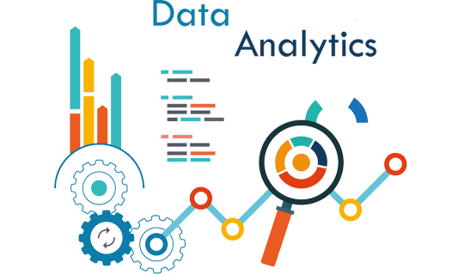
Definition
Data analysis is the process of cleaning, changing, and processing raw data, and extracting actionable, relevant information that helps businesses make informed decisions.
3
Notes:
SAY: Before we wrap up the course, let’s review what we have learned today.
During this course, we have
<READ the bullets from the slide.>
GO to next slide.

Slide 4
Introduction
A simple example of data analysis can be seen whenever we take a decision in our daily lives by evaluating what has happened in the past or what will happen if we make that decision.
Basically, this is the process of analyzing the past or future and making a decision based on that analysis.
4
Notes:
SAY: Before we wrap up the course, let’s review what we have learned today.
During this course, we have
<READ the bullets from the slide.>
GO to next slide.

Slide 5
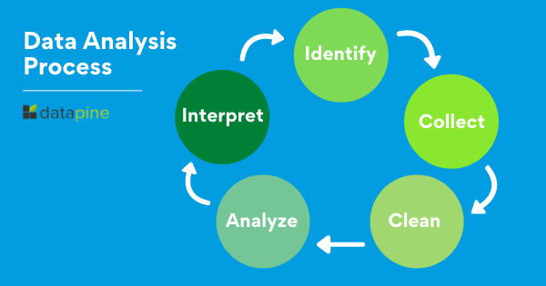
5
Notes:
SAY: Before we wrap up the course, let’s review what we have learned today.
During this course, we have
<READ the bullets from the slide.>
GO to next slide.

Slide 6
Why is Data Analysis Important?
Better Customer Targeting:
You don’t want to waste your business’s precious time, resources, and money putting together advertising campaigns targeted at demographic groups that have little to no interest in the goods and services you offer.
Data analysis helps you see where you should be focusing your advertising efforts.
●●●
6
Notes:
SAY:
The purpose of epidemiology in public health practice is to
discover the agent, host, and environmental factors that affect health;
determine the relative importance of causes of illness, disability, and death;
identify those segments of the population that have the greatest risk from specific causes of ill health; and
evaluate the effectiveness of health programs and services in improving population health.
GO to next slide.

Slide 7
Why is Data Analysis Important?
You Will Know Your Target Customers Better:
Data analysis tracks how well your products and campaigns are performing within your target demographic.
Through data analysis, your business can get a better idea of your target audience’s spending habits, disposable income, and most likely areas of interest
●●●
7
Notes:
SAY:
The purpose of epidemiology in public health practice is to
discover the agent, host, and environmental factors that affect health;
determine the relative importance of causes of illness, disability, and death;
identify those segments of the population that have the greatest risk from specific causes of ill health; and
evaluate the effectiveness of health programs and services in improving population health.
GO to next slide.

Slide 8
Why is Data Analysis Important?
Reduce Operational Costs:
Data analysis shows you which areas in your business need more resources and money, and which areas are not producing and thus should be scaled back or eliminated outright.
●●●
8
Notes:
SAY:
The purpose of epidemiology in public health practice is to
discover the agent, host, and environmental factors that affect health;
determine the relative importance of causes of illness, disability, and death;
identify those segments of the population that have the greatest risk from specific causes of ill health; and
evaluate the effectiveness of health programs and services in improving population health.
GO to next slide.

Slide 9
Why is Data Analysis Important?
Better Problem-Solving Methods:
Informed decisions are more likely to be successful decisions. Data provides businesses with information. You can see where this progression is leading.
Data analysis helps businesses make the right choices and avoid costly pitfalls.
●●●
9
Notes:
SAY:
The purpose of epidemiology in public health practice is to
discover the agent, host, and environmental factors that affect health;
determine the relative importance of causes of illness, disability, and death;
identify those segments of the population that have the greatest risk from specific causes of ill health; and
evaluate the effectiveness of health programs and services in improving population health.
GO to next slide.

Slide 10
Why is Data Analysis Important?
You Get More Accurate Data:
If you want to make informed decisions, you need data, but there’s more to it. The data in question must be accurate.
Data analysis helps businesses acquire relevant, accurate information, suitable for developing future marketing strategies, business plans, and realigning the company’s vision or mission.
10
Notes:
SAY:
The purpose of epidemiology in public health practice is to
discover the agent, host, and environmental factors that affect health;
determine the relative importance of causes of illness, disability, and death;
identify those segments of the population that have the greatest risk from specific causes of ill health; and
evaluate the effectiveness of health programs and services in improving population health.
GO to next slide.

Slide 11
Data Analysis Process
Data Requirement Gathering:
Ask yourself why you’re doing this analysis, what type of data analysis you want to use, and what data you are planning on analyzing.
Data Collection:
Guided by the requirements you’ve identified, it’s time to collect the data from your sources.
●●●
11
Notes:
SAY:
The purpose of epidemiology in public health practice is to
discover the agent, host, and environmental factors that affect health;
determine the relative importance of causes of illness, disability, and death;
identify those segments of the population that have the greatest risk from specific causes of ill health; and
evaluate the effectiveness of health programs and services in improving population health.
GO to next slide.

Slide 12
Data Analysis Process
Data Cleaning:
Not all of the data you collect will be useful, so it’s time to clean it up. This process is where you remove white spaces, duplicate records, and basic errors.
Data Analysis:
Here is where you use data analysis software and other tools to help you interpret and understand the data and arrive at conclusions.
●●●
12
Notes:
SAY:
The purpose of epidemiology in public health practice is to
discover the agent, host, and environmental factors that affect health;
determine the relative importance of causes of illness, disability, and death;
identify those segments of the population that have the greatest risk from specific causes of ill health; and
evaluate the effectiveness of health programs and services in improving population health.
GO to next slide.

Slide 13
Data Analysis Process
Data Interpretation:
Now that you have your results, you need to interpret them and come up with the best courses of action, based on your findings.
Data Visualization:
Data visualization is a fancy way of saying, “graphically show your information in a way that people can read and understand it.”
13
Notes:
SAY:
The purpose of epidemiology in public health practice is to
discover the agent, host, and environmental factors that affect health;
determine the relative importance of causes of illness, disability, and death;
identify those segments of the population that have the greatest risk from specific causes of ill health; and
evaluate the effectiveness of health programs and services in improving population health.
GO to next slide.

Slide 14
Types of Data Analysis
Diagnostic Analysis:
Diagnostic analysis answers the question, “Why did this happen?” Using insights gained from statistical analysis (more on that later!), analysts use diagnostic analysis to identify patterns in data. Ideally, the analysts find similar patterns that existed in the past, and consequently, use those solutions to resolve the present challenges hopefully.
●●●
14
Notes:
SAY:
The purpose of epidemiology in public health practice is to
discover the agent, host, and environmental factors that affect health;
determine the relative importance of causes of illness, disability, and death;
identify those segments of the population that have the greatest risk from specific causes of ill health; and
evaluate the effectiveness of health programs and services in improving population health.
GO to next slide.

Slide 15
Types of Data Analysis
Predictive Analysis:
Predictive analysis answers the question, “What is most likely to happen?” By using patterns found in older data as well as current events, analysts predict future events.
While there’s no such thing as 100 percent accurate forecasting, the odds improve if the analysts have plenty of detailed information and the discipline to research it thoroughly.
●●●
15
Notes:
SAY:
The purpose of epidemiology in public health practice is to
discover the agent, host, and environmental factors that affect health;
determine the relative importance of causes of illness, disability, and death;
identify those segments of the population that have the greatest risk from specific causes of ill health; and
evaluate the effectiveness of health programs and services in improving population health.
GO to next slide.

Slide 16
Types of Data Analysis
Prescriptive Analysis:
Mix all the insights gained from the other data analysis types, and you have prescriptive analysis.
Sometimes, an issue can’t be solved solely with one analysis type, and instead requires multiple insights.
●●●
16
Notes:
SAY:
The purpose of epidemiology in public health practice is to
discover the agent, host, and environmental factors that affect health;
determine the relative importance of causes of illness, disability, and death;
identify those segments of the population that have the greatest risk from specific causes of ill health; and
evaluate the effectiveness of health programs and services in improving population health.
GO to next slide.

Slide 17
Types of Data Analysis
Statistical Analysis:
Statistical analysis answers the question, “What happened?” This analysis covers data collection, analysis, modeling, interpretation, and presentation using dashboards.
●●●
17
Notes:
SAY:
The purpose of epidemiology in public health practice is to
discover the agent, host, and environmental factors that affect health;
determine the relative importance of causes of illness, disability, and death;
identify those segments of the population that have the greatest risk from specific causes of ill health; and
evaluate the effectiveness of health programs and services in improving population health.
GO to next slide.

Slide 18
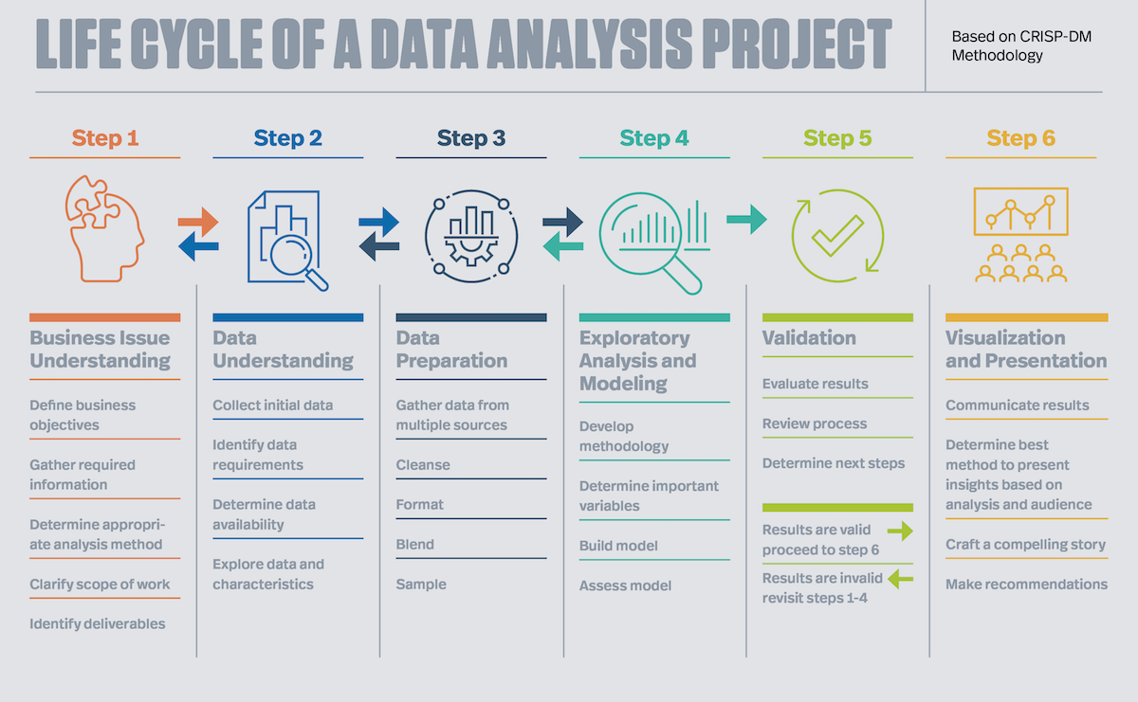

Slide 19
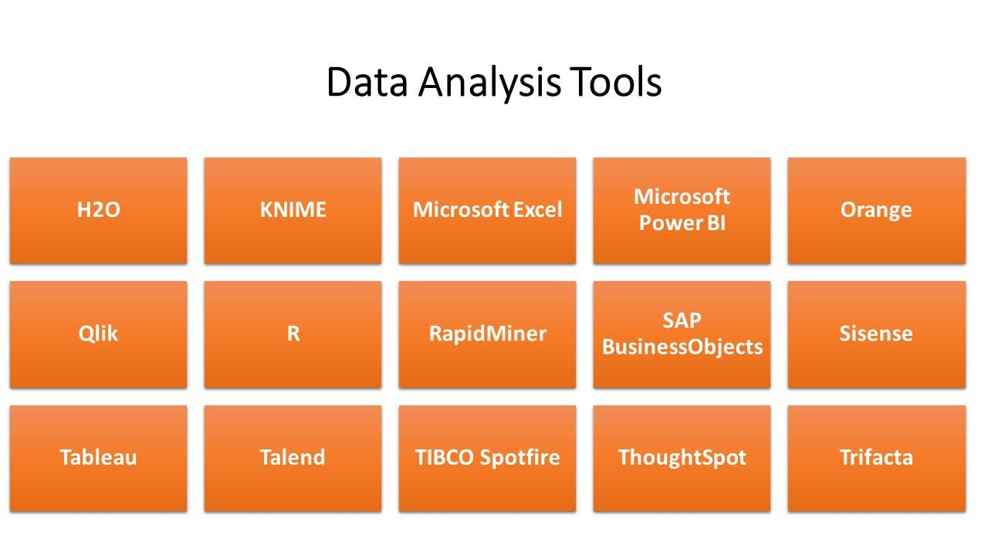

Slide 20
H2O, an AI-based platform that excels at identifying patterns in collected data
KNIME, which data analysts use to build machine learning solutions and visualize data
Microsoft Excel, which lets non-analysts perform basic analysis on numerical data—and display their results in easy-to-understand charts
Microsoft Power BI, a popular business intelligence platform with powerful data visualization capabilities
Orange, a toolkit for data mining, machine learning, and data visualizations
Qlik, a powerful yet easy-to-use tool for data visualization
R Project, a free, open-source project that focuses on statistical computing and graphics

Slide 21
RapidMiner, an enterprise-level data science platform for machine learning, deep learning, and other advanced data analysis
SAP BusinessObjects, a suite of business analysis applications for data discovery, analysis, and reporting
Sisense, a data analytics platform designed for both business analysts and technical developers
Tableau, a free interactive data visualization tool
Talend, an open-source cloud-based data analysis tool
TIBCO Spotfire, a natural-language data analytics platform with natural language search powered by AI technology
ThoughtSpot, a data analytics platform with advanced reporting and natural language searching
Trifacta, an open source tool for transforming raw data into structured formats

Slide 22
Conclusion
Data analysis includes the inspection, modification, modeling, and transforming of data as per the need of the research topic.
The conclusion is the final inference drawn from the data analysis, review of literature, and findings.
22
Notes:
SAY:
The purpose of epidemiology in public health practice is to
discover the agent, host, and environmental factors that affect health;
determine the relative importance of causes of illness, disability, and death;
identify those segments of the population that have the greatest risk from specific causes of ill health; and
evaluate the effectiveness of health programs and services in improving population health.
GO to next slide.

